Slide 1
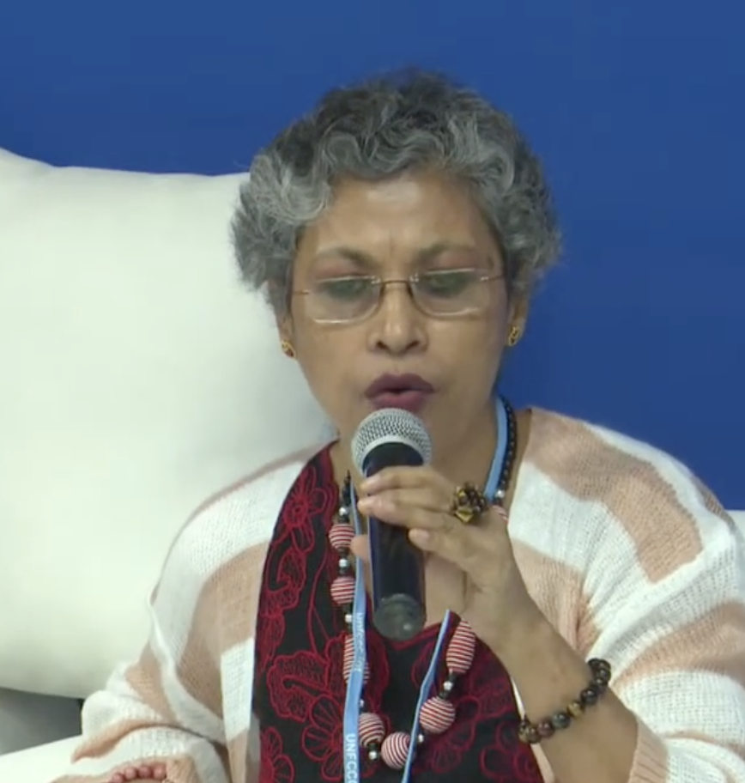
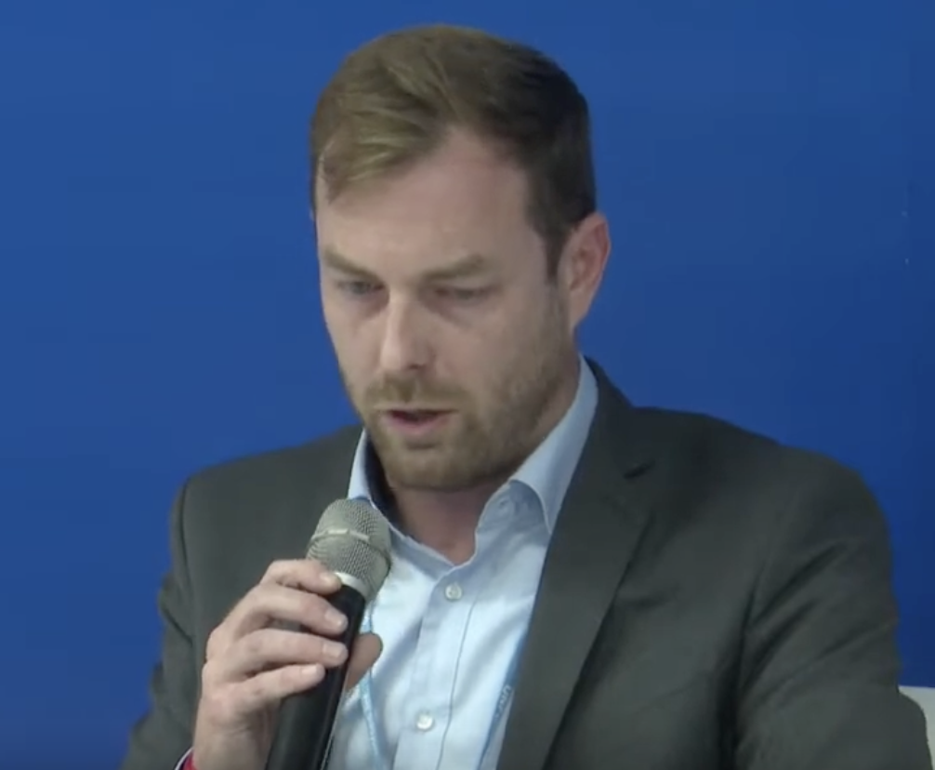
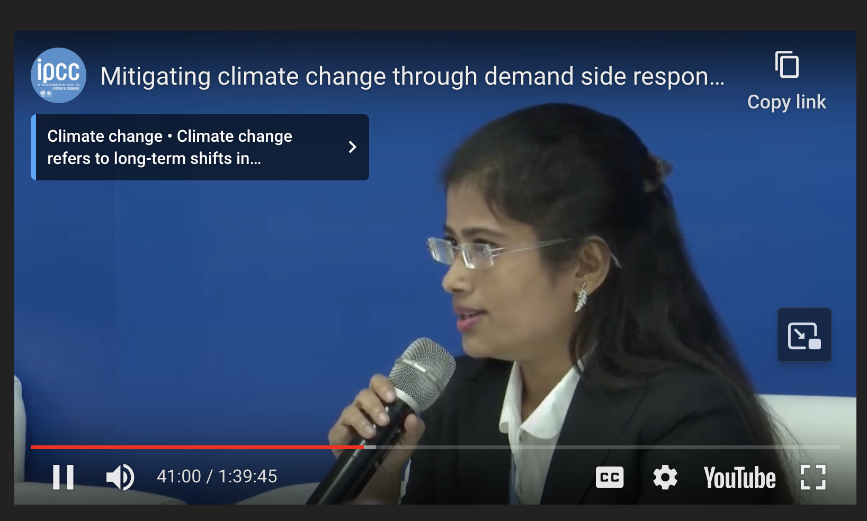

Recap: IPCC Panel Discussion on mitigating climate change through demand side reductions
Joyashree Roy, Jadavpur University
David McCollum, Oak Ridge Nat’l Lab
Shreya Some, Asia Institute of Technology
Nick Eyre, Oxford

Slide 2
Some of your comments … and noting that the word “model” is used in multiple ways
the actions of a few can have an exponential impact on the emissions of many
challenges to demand-side mitigation may look like ineffective campaigning/promotion or partiality from leaders
supply-side change feels more like a behind-the-scenes action, while demand-side change requires everyday lifestyle shifts
Understanding the trends of consumption and the social norms of consumption might help understand realistic mitigation … “could I provide this service in a different way, without using that energy?”
Demand-side mitigation was also framed as a systemic issue, not just an individual one
how to create a society that uses public transportation as the norm, compared to methods of personal transportation
framing the situation as an opportunity for people with high incomes to be role models … creating new social norms
a carbon tax may be of sufficient magnitude to dissuade lower-income consumers from flying, driving too much, etc., but have no effect on the behavior of the wealthy, who contribute the most to climate change in the first place
Mixing this societal and cultural change with improvements in architecture and technology
Socio-cultural effects, such as altering consumer preference or implementing policies that produce a new standard of carbon acceptance
some communities have limitations that restrict them from having access to making greener choices
Shifting norms is politically and personally difficult
Models are important because they create platforms to discuss what kinds of changes are needed
There would have to be a revolution in the way we do just about everything
the question often arises about whether or not what the individual does really matters
a lack of research in demand based mitigation
climate change is perhaps the ultimate tragedy of the commons
models are not used to predict the future, but to show different options and to show what is missing
we want to ensure that the models we are using are representative, factual, and more importantly necessary
a cascade effect, where every unit of energy not consumed on the demand side leads to several units of energy not extracted on the supply/resource side

Slide 3
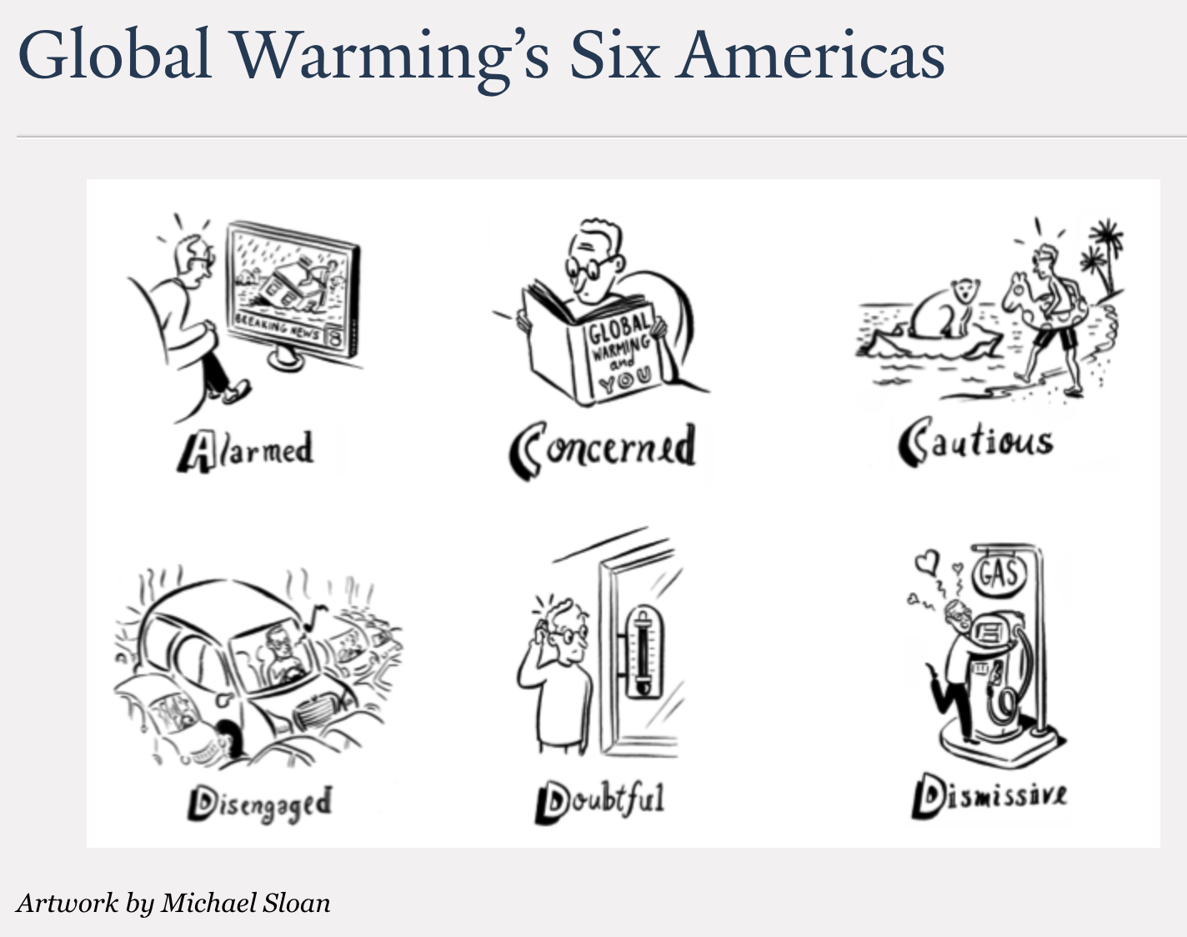
Adding to our rhetorical toolbox: the six Americas
https://climatecommunication.yale.edu/about/projects/global-warmings-six-americas/
Rowe’s replacement technique:
Replace one word or concept with another, to see how it sits.
Schrepfer’s power analysis
How does it function? (Or: What is its goal?)
Who does it benefit?
Where is the power?

Slide 4
Today is about data collection
In groups of 2-3, choose somebody to start their narrative, and a scribe. It might be helpful to agree on rules, like safe space.
As narrator, describe a conversation involving climate change that left you uncertain as to how to proceed. Flesh it out with some context – which of the “Six Americas” would you say your conversation partner belongs to? Was there something left unsaid?
The scribe should record (anonymously) in our shared google doc (see the link in Canvas).
Rotate until everybody has had a chance to share a few conversations.

Slide 5
By Saturday night: A letter from the future me in your research notebook
(See the prompt in Canvas)

